Slide 1
MISSING CHILD IDENTIFICATION USING CNN
Mrs.R.Vijaya Lakshmi
Internal Supervisor
Mrs. U.Chaitanya
IOMP Supervisor
IOMP-25-17
G.HARSHITHA-22261A121
J.SHYAMALA-22261A1225

Slide 2

MAHATMA GANDHI INSTITUTE OF TECHNOLOGY
DEPARTMENT OF INFORMATION TECHNOLOGY
An Industry Oriented Mini Project(CB652PC)
on
MISSING CHILD IDENTIFICATION USING CNN
by
G.HARSHITHA-22261A1221
J.SHYAMALA-22261A1225
Batch ID:IT-25-17
Internal Supervisor IOMP Supervisor
Mrs.R.Vijaya Lakshmi Mrs.U.Chaitanya
Assistant Professor Assistant Professor

Slide 3
OUTLINE
ABSTRACT
INTRODUCTION
EXISTING SYSTEM
PROPOSED SYSTEM
APPLICATIONS
REQUIREMENTS
LITERATURE SURVERY
PROBLEM STATEMENT
OBJECTIVES
MODULES DESCRIPTION
ALGORITHM
DESIGN
CODE EXECUTION / RESULT
TEST CASES
CONCLUSION AND FUTURE ENHANCEMENT
REFERENCES

Slide 4
ABSTRACT
Every year, many children go missing in India, and timely identification remains a challenge. This project proposes a facial recognition-based system to assist in identifying and reuniting missing children with their families. The system leverages a pre-trained ResNet-based Convolutional Neural Network (CNN) through the dlib library to extract deep facial features and generate facial encodings. These encodings are then compared against a database of known images to identify potential matches. User-uploaded images are processed, and if a match is found, the result is displayed on a web page, and an automated email notification is sent to the parent or guardian using SMTP. The system is lightweight, accurate, and scalable, making it suitable for integration with police databases, public surveillance platforms, and online portals to enhance child safety efforts.

Slide 5
INTRODUCTION
Challenge – Traditional methods for identifying missing children, such as manual matching and law enforcement databases, are slow and ineffective due to changes in appearance over time.
Proposed Solution – CNN-based facial recognition systems can accurately detect and match missing children's faces using advanced feature extraction techniques.
Key Features – CNNs handle variations like aging, lighting conditions, and pose changes by training on large datasets to identify unique facial patterns.
Integration and Impact – This system can be deployed in law enforcement agencies, NGOs, and public databases to automatically match found children with missing person records, improving identification efficiency.
Technology Used – Pre-trained CNN models like FaceNet, VGGFace, and ResNet enhance accuracy, making the system a powerful tool for reuniting missing children with their families.

Slide 6
EXISTING SYSTEM
Families must physically visit police stations or child welfare centers with photographs to try and identify the child
Authorities rely on eyewitness reports and human memory, which is unreliable and time-consuming.
There is no automatic or intelligent system in place to match found children with reported missing ones.
It may take days or weeks to cross-verify records.
Information about missing children is stored in files, spreadsheets, or simple databases, which cannot handle image-based matching.
No support for face recognition or photo comparison.
Once a child is found, the parent or guardian is contacted manually via phone or in person, causing delays.
No automated communication or alert system.

Slide 7
PROPOSED SYSTEM
Utilizes the face recognition library and a CNN model for accurate face matching.
Automatically compares uploaded photos with stored images for potential matches.
Features an easy-to-use interface to add missing children and search using images, with no technical skills required for use.
Detects and compares faces immediately after upload, displaying match results instantly.
Sends an email notification to the parent if a match is found, including the child’s image to help speed up reunions.
Stores data in a JSON file, simplifying management and accessibility, with images saved in a simple folder structure.
Can be hosted online or run locally on any device with a browser, accessible from any platform including mobile and desktop.

Slide 8
APPLICATIONS
Identify missing children using face recognition.
Used by police and NGOs to reunite families.
Helps hospitals and shelters identify lost kids.
Assists in disasters to locate separated children.
Can be installed at schools to track and protect students.

Slide 9
SOFTWARE AND HARDWARE REQUIREMENTS
Software Requirements:
Programming Language: Python
Libraries: Flask, face recognition, smtplib, json
Database: JSON file storage
Web Browser: Any modern browser
Email Server: SMTP (Gmail)
Hardware Requirements :
Processor: Intel i5
RAM: 8GB
Storage: 256GB SSD

Slide 10
LITERATURE SURVEY
S.No | Author(s), Year | Journal/Conference | Methodology/Techniques | Merits | Demerits | Research Gaps
1 | Sharma et al., 2023 | Elsevier – Expert Systems with Applications | Deep CNN with face re-identification for missing children | High precision in facial feature matching | Low performance on aged or occluded faces | Needs robust aging models and real-world deployment studies
2 | Zhang et al., 2022 | IEEE Access | GAN-based facial age progression framework | Realistic age-transformed face synthesis | Risk of visual artifacts and hallucinations | Lack of real-time capability for surveillance systems
3 | Ahmed et al., 2021 | Springer – Multimedia Tools and Applications | Hybrid deep learning and SIFT for child face recognition | Better generalization across datasets | Less accurate in very young children | Limited testing on diverse populations
4 | Reddy et al., 2020 | ACM Transactions on Multimedia Computing | Mobile app-based solution using cloud and facial recognition | Practical deployment in public spaces | Dependent on internet access and cloud latency | Needs more secure and privacy-compliant architecture
5 | Banerjee & Kumar, 2019 | IEEE Sensors Journal | IoT and GPS wearable tech integrated with facial tracking | Real-time tracking and alert generation | Device tampering and privacy concerns | Lacks standardization for nationwide or international scale tracking systems
6 | Nagamani et al., 2025 | IJARCCE | CNN with transfer learning for missing child identification | High precision and recall; scalable architecture | Potential privacy concerns | Integration with law enforcement databases

Slide 11
PROBLEM STATEMENT
Current methods for identifying and reuniting missing children are manual, slow, and often inaccurate. The lack of real-time facial recognition and automated alerts leads to delays. A smart, reliable system is needed to match faces quickly, notify guardians instantly, and assist authorities in reuniting children with their families.

Slide 12
OBJECTIVES
Allow users to register a child's face with name and email for future matching.
Compare uploaded unknown face images with stored faces to identify a match.
Use metrics like accuracy, precision, and confusion matrix to evaluate model performance.
Send an email to the registered address if a matching face is found.

Slide 13
MODULES DESCRIPTION
Image Upload Module - Allows users to upload images of missing or found children, storing them securely with sanitized filenames for easy processing.
Face Recognition and Comparison Module - Uses the face_recognition library to detect and compare faces in the uploaded images with those in the stored records to identify potential matches.
Data Storage Module - Stores missing children's details (name, email, image) in a JSON file and ensures images are organized in a designated folder for future reference.
Email Notification Module - Automatically sends an email notification to the guardian when a match is found, including the child’s details and a photo of the matched child.
User Interface Module - Provides a simple and easy-to-use web interface for users to upload images, add new records for missing children, and view the results of face matching.
6. Evaluation and Visualization Module – Calculates accuracy, precision, and displays a confusion matrix to
visualize prediction results and model performance using Seaborn and Matplotlib.

Slide 14
Backend Processing Module - Handles image uploads, processes them for face recognition, and compares uploaded faces with stored ones to find matches.
Data Saving and Loading Module - Loads existing data and updates the JSON file whenever new information about missing children is added or modified.
Security and File Handling Module - Validates and securely saves the uploaded images, ensuring they are stored safely and are accessible for face comparison

Slide 15
ALGORITHMIC MODEL
Image Upload - User uploads an image of a child through the web interface.
Face Detection and Encoding - The system detects a face in the uploaded image and extracts facial features (encodings) using the face_recognition library.
Load Stored Data - Previously stored images and their corresponding encodings are loaded from a folder and JSON file.
Face Comparison - The uploaded face encoding is compared with stored encodings to find a match using a face comparison algorithm.
Match Decision - If a match is found, details like the child's name and parent's email are retrieved.
Email Notification - An email with the child's photo and information is automatically sent to the parent's registered email address.
Display Result - The web app shows whether a match was found, and if so, displays both images (uploaded and matched).

Slide 16
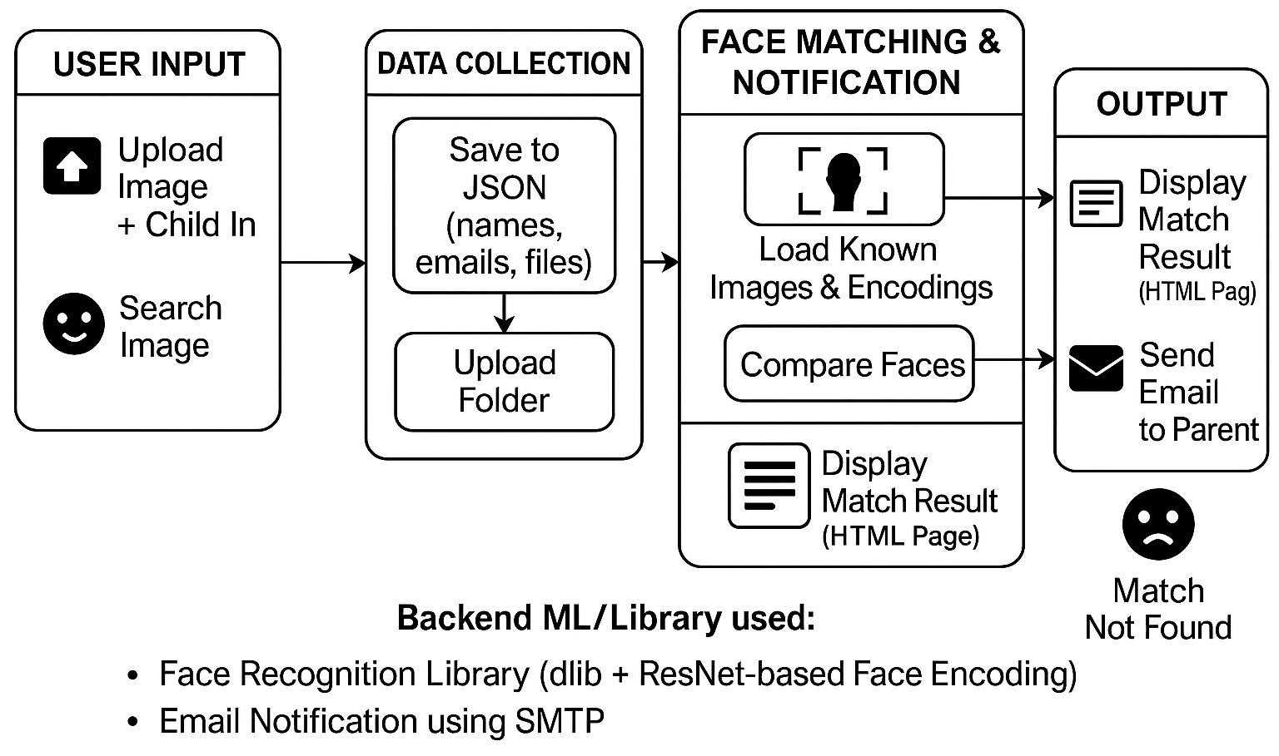
DESIGN ARCHITECTURE

Slide 17
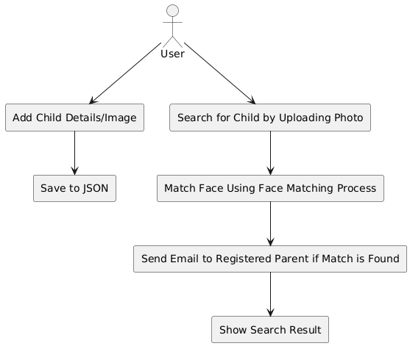
UML DIAGRAMS
Use Case Diagram

Slide 18
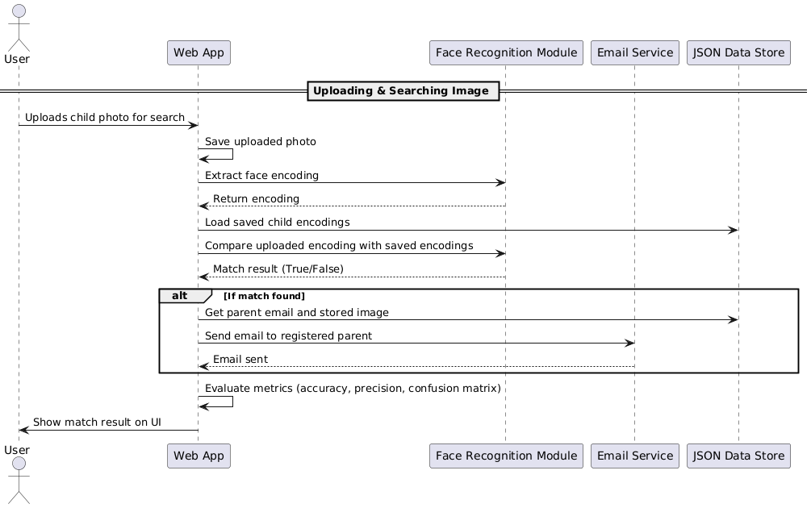
Sequence Diagram

Slide 19
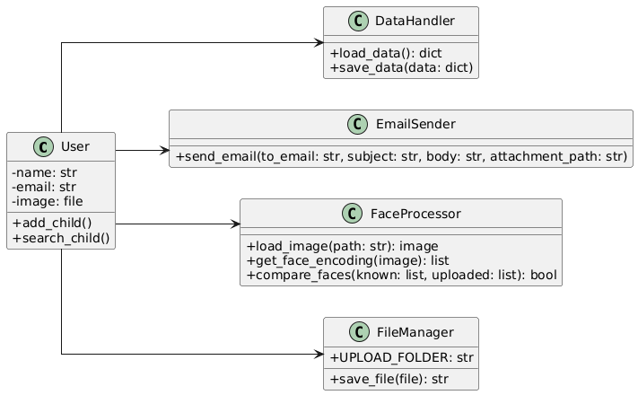

Class Diagram

Slide 20
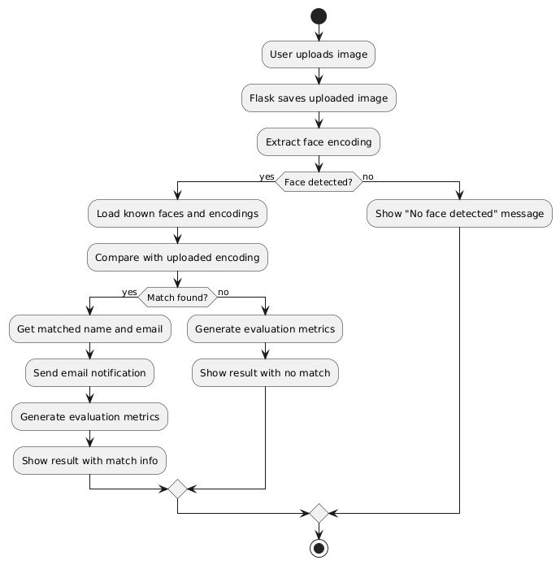
Activity Diagram

Slide 21
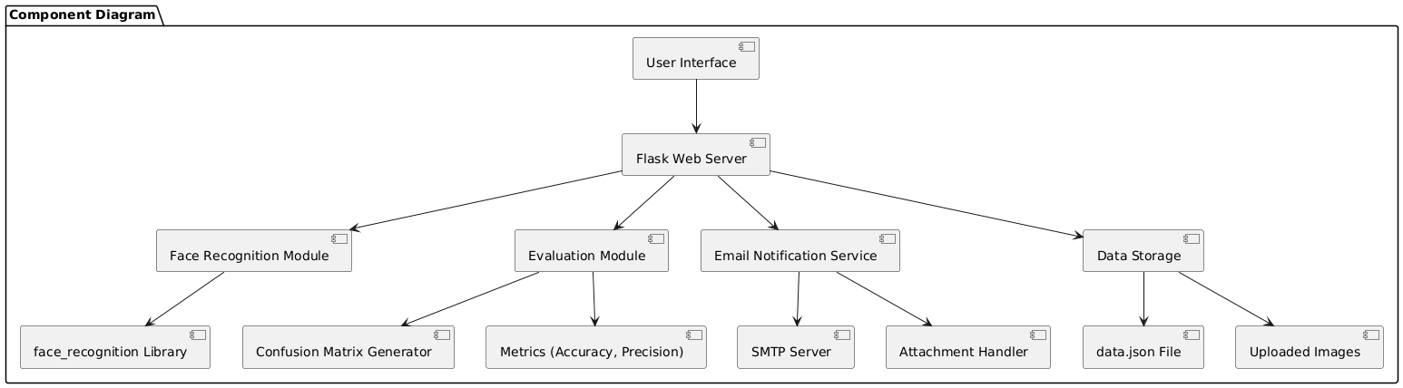
Component Diagram

Slide 22
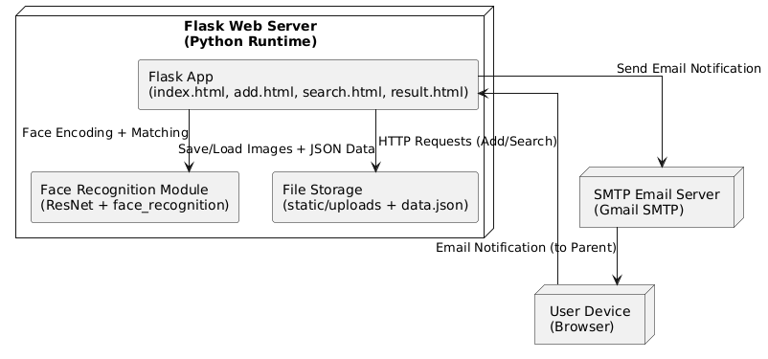
Deployment Diagram

Slide 23
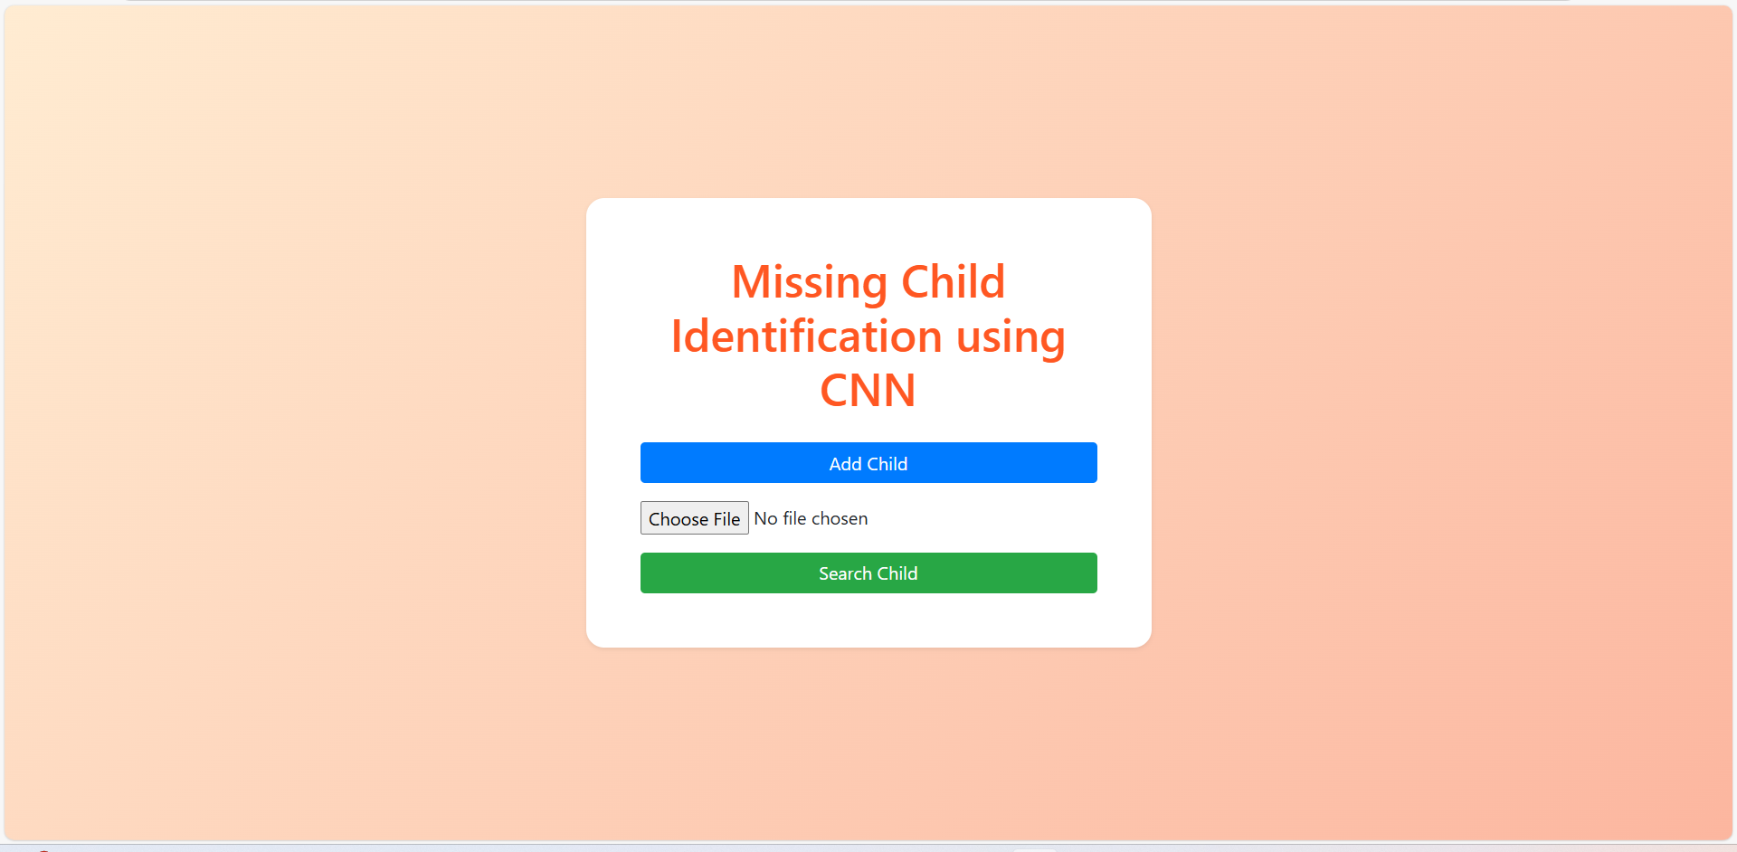
RESULTS
Fig: Initial page

Slide 24


Fig :Input page

Slide 25


Fig: Search image page

Slide 26
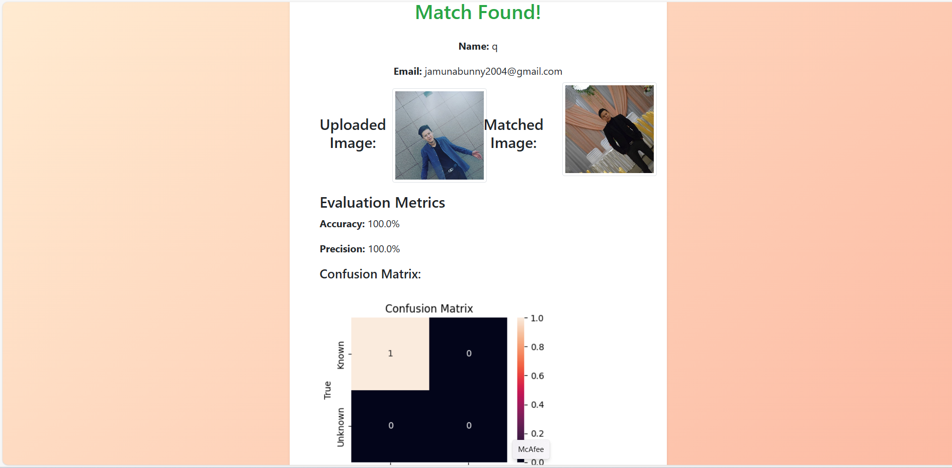
Fig: match found page

Slide 27
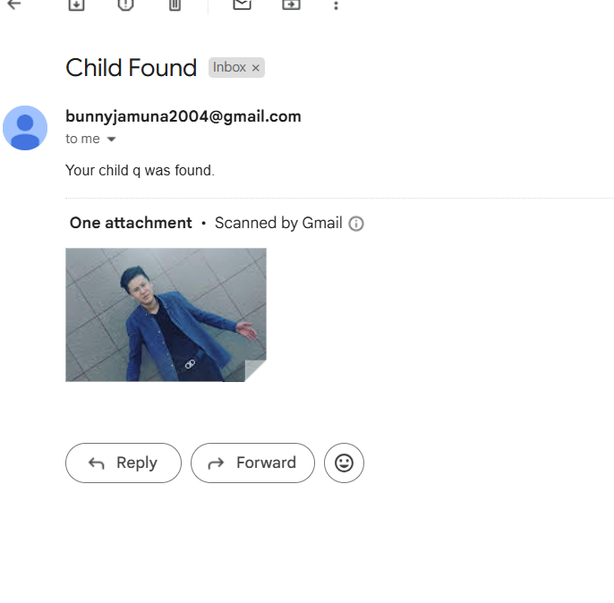
Fig: Email Notification – Child Found

Slide 28
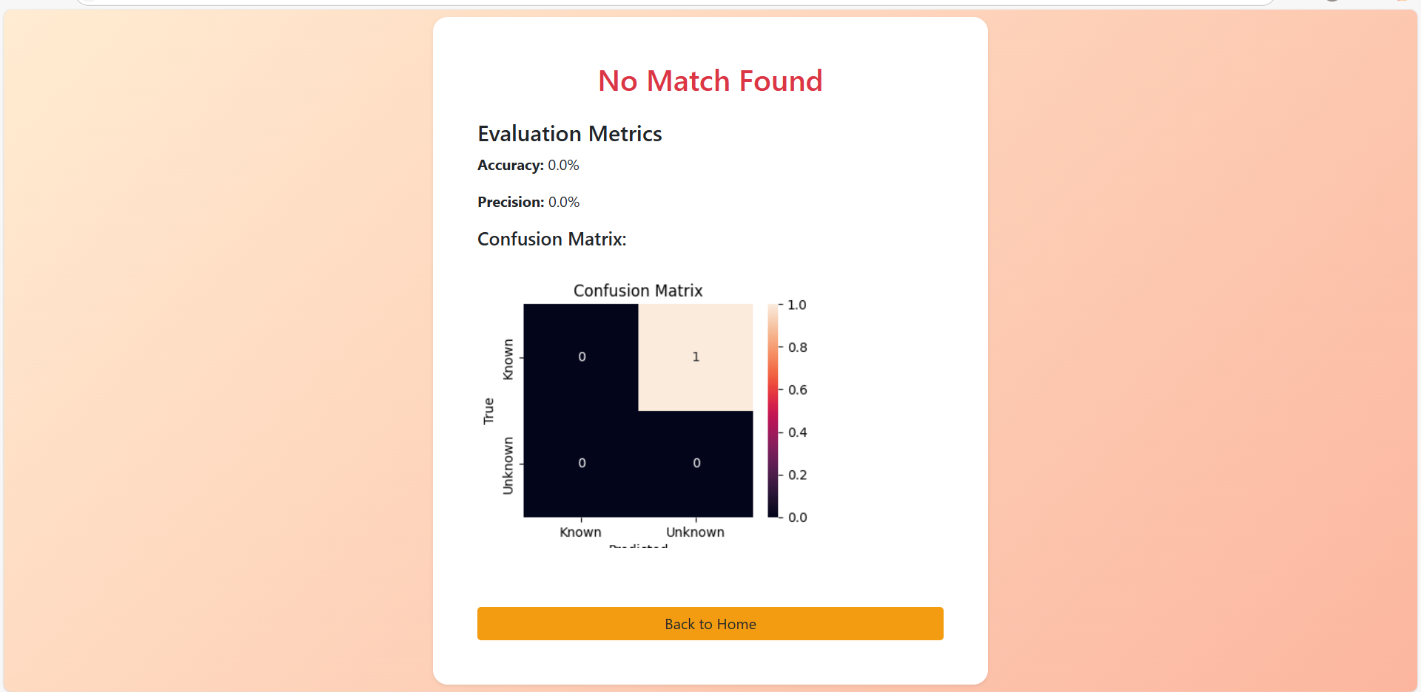
Fig: No Match Found

Slide 29
TEST CASES
S. No | Test Case Name | Input | Expected Output | Actual Output | Remarks
1 | Add Child - Valid | Name, Email, Clear Image | Data saved, image stored | Data saved, image stored | Pass
2 | Add Child - No Image | Name, Email (No Image) | Show error, don’t save | Show error, don’t save | Pass
3 | Search Child - Match Found | Upload known image | Match shown, email sent | Match shown, email sent | Pass
4 | Search Child - No Match | Upload unknown image | Show "No match found" | Show "No match found" | Pass
5 | Upload Image - No Face | Upload random image (no face) | Show "No face found" | Show "No face found" | Pass
6 | Email Error Handling | Enter invalid email | Catch and log email error | Catch and log email error | Pass

Slide 30
FUTURE ENHANCEMENT
Improved Face Recognition Accuracy - Enhance the system by using advanced CNN models for better accuracy under varied lighting and aging effects.
Real-Time Video Processing - Enable support for analyzing live CCTV footage to identify missing children in real time.
Multi-Face Detection in a Single Image - Allow the system to detect and match multiple faces in a group photo, improving usability in real-world scenarios.
Mobile Application - Create a mobile app for faster field use by police, NGOs, and volunteers.
Integration with Government Databases - Link the system with official child welfare or police databases for wider and verified reach.

Slide 31
CONCLUSION
This web application effectively utilizes face recognition technology to identify missing children and notify their parents via email. With its user-friendly interface and robust functionality, it demonstrates a practical approach to leveraging facial recognition for child safety and recovery. The system's ability to quickly and accurately identify missing children can significantly enhance the efficiency of search efforts and provide timely reunions. Future enhancements can further improve its effectiveness and efficiency, making it an invaluable tool for authorities, families, and communities worldwide. By using the power of technology, we can work towards creating a safer environment for children and providing peace of mind for their loved ones..

Slide 32
REFERENCES
[1]. O. M. Parkhi, A. Vedaldi, and A. Zisserman, “Deep face recognition,” British Machine Vision Conference (BMVC), 2015.
[2]. F. Schroff, D. Kalenichenko, and J. Philbin, “FaceNet: A unified embedding for face recognition and clustering,” in Proceedings of the 2015 IEEE Conference on Computer Vision and Pattern Recognition (CVPR), pp. 815–823, 2015.
[3]. G. V. Prasad and R. S. Nair, “Smart web application for facial recognition using Flask and OpenCV,” in 2020 IEEE International Conference on Smart Technologies and Systems for Next Generation Computing (ICSTSN), Chennai, India, 2020, pp. 1–6.
[4] Y. Taigman, M. Yang, M. Ranzato, and L. Wolf, “DeepFace: Closing the gap to human-level performance in face verification,” in Proceedings of the 2014 IEEE Conference on Computer Vision and Pattern Recognition (CVPR), Columbus, OH, USA, 2014, pp. 1701–1708.

Slide 33
[5]. T. P. Lakshmi and K. R. Rani, “Smart security system using image processing and email alerts,” in 2016 IEEE International Conference on Computation System and Information Technology for Sustainable Solutions (CSITSS), Bengaluru, India, 2016, pp. 176–180.

Slide 34
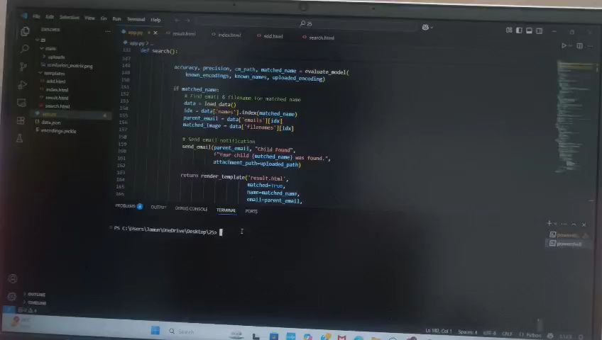

Slide 35
THANK YOU

